Slide 1
B.M.Mounika Devi
Final Project
3/21/2024 Annual Review

Slide 2

KEYLOGGER SECURITY
3/21/2024 Annual Review
This Photo by Unknown Author is licensed under CC BY-ND

Slide 3
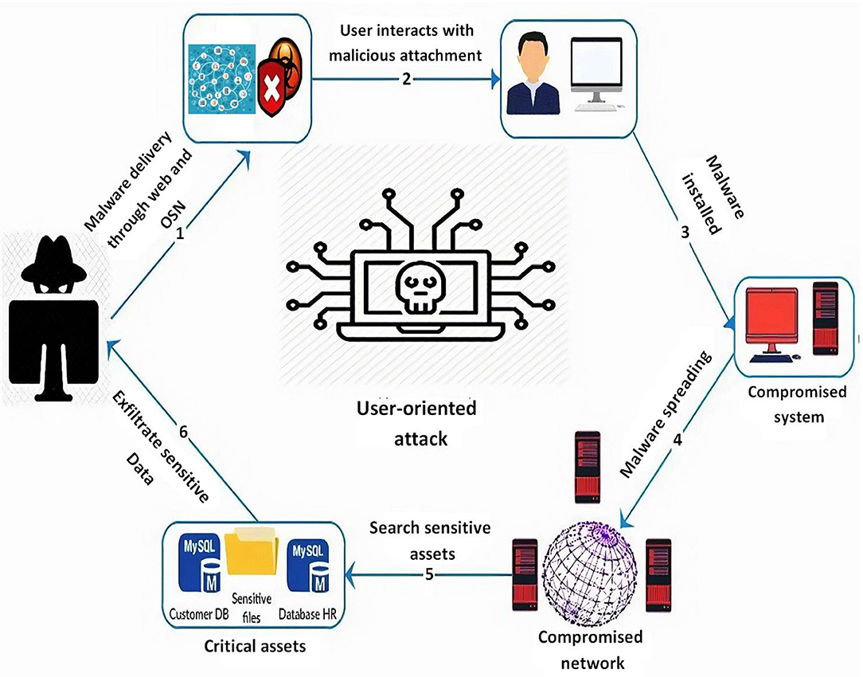


AGENDA
A keylogger, short for "keystroke logger," is a software or hardware device that captures and records the
keystrokes typed on a computer or other input devices, such as keyboards. The software is installed on a
computer and records everything the user types. In a cyberattack, a keylogger records all the passwords
and credit card numbers you type and all the web pages you visit. Then, the keylogger sends this
information to a server, where cybercriminals wait to use all this sensitive information.
3/21/2024 Annual Review
This Photo by Unknown Author is licensed under CC BY

Slide 4

PROBLEM STATEMENT
Keyloggers can be detected using antiviruses. Installation of hardware keyloggers is difficult without the knowledge of the owner of the system. The solution to the above existing problem is that we can build a software keyloggers instead of hardware keyloggers.
3/21/2024 Annual Review

Slide 5

PROJECT OVERVIEW
Keylogger program may enter your system through various channels, either online or offline means, some of which are:
The malware program may get installed when accessing email from an unknown source or an attachment in the email.
Keylogger may also enter the device when surfing the Internet or clicking random pop-ups.
The system may also get infected with the keylogger program when installing applications from uncertified sources
Using unidentified physical storage devices like pen drives and then accessing its content may lead to installing the keylogger program.
3/21/2024 Annual Review

Slide 6
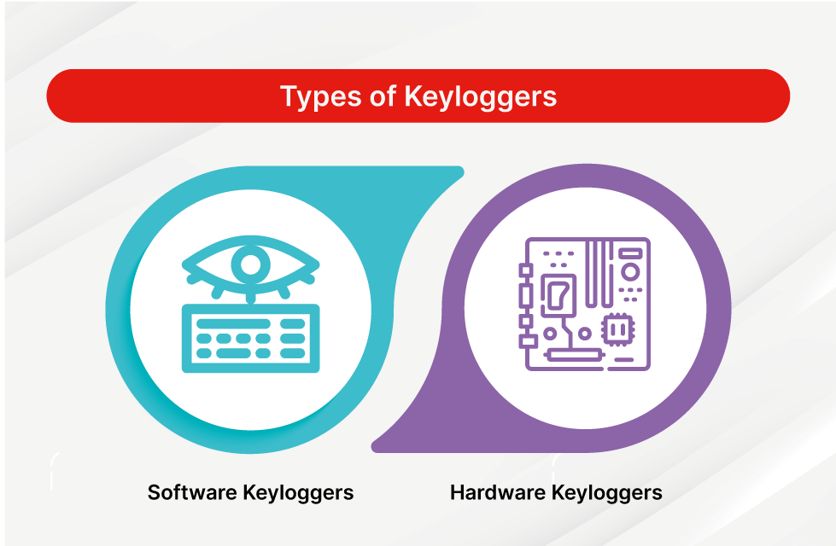

WHO ARE THE END USERS?
By employers to observe employees' computer activities.
By parents to supervise their children's internet usage.
By device owners to track possible unauthorized activity on their devices.
By law enforcement agencies to analyze incidents involving computer use.
3/21/2024 Annual Review

Slide 7

YOUR SOLUTION AND ITS VALUE PROPOSITION
To remove the program, you can refer to the following points:
Removing any suspicious add-on from the internet which might be the source of infection.
Deleting unknown data files or folders from the system.
Uninstallation of uncertified software and applications from the system.
3/21/2024 Annual Review

Slide 8

Preventing Keylogger Infection:
Like other malware programs, the keylogger program can be prevented from entering if correct precautions are taken. This might protect your data from getting logged by the keylogger program for malicious purposes.
To prevent the system from getting installed/infected with the keylogger program, you can refer to some of the below-mentioned points as reference:
Regular antivirus scans to check any unusual activity from software or an application and prevent it from affecting our system.
Visiting trusted and certified websites on the internet to prevent the installation of keylogger programs in the system.
Avoid clicking on any random pop-ups from sites
Use the Virtual Keyboard (On-Screen Keyboard) when typing sensitive data such as login details, passwords, or bank details.
Use certified software and applications from a trusted source to avoid getting infected with the keylogger program.
3/21/2024 Annual Review
8

Slide 9
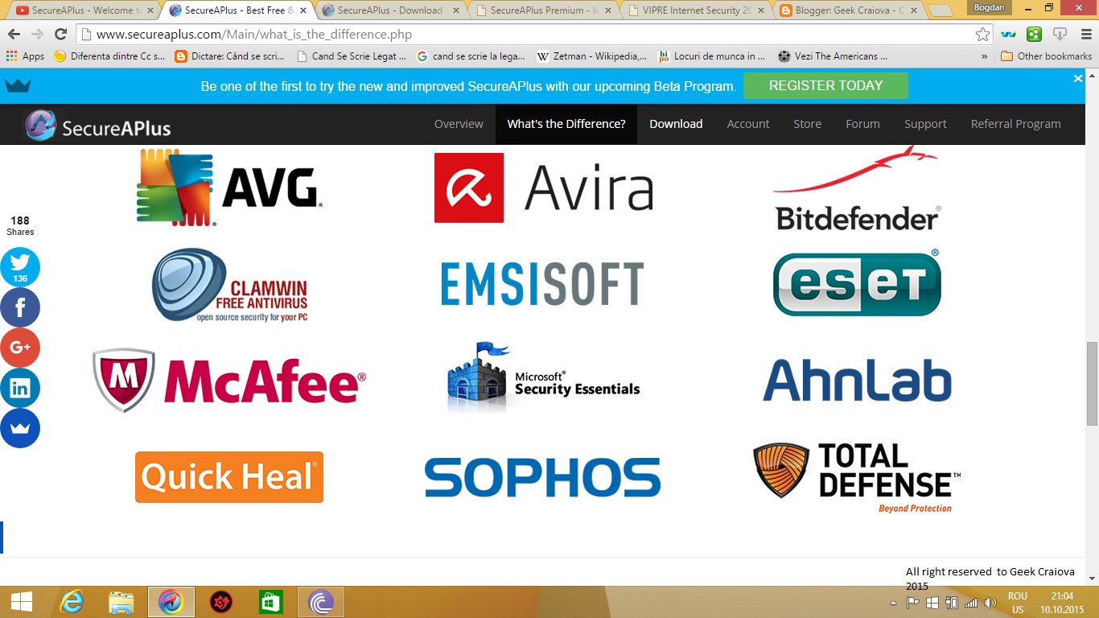
Some of the Anti-virus softwares:
This Photo by Unknown Author is licensed under CC BY
3/21/2024 Annual Review
9

Slide 10
RESULTS
Keyloggers are a potent threat to both individuals and enterprises, with the potential to cause significant harm if left undetected. Understanding the nature of keyloggers, their methods of infiltration, and the dangers they pose is crucial for maintaining a secure digital environment.
To protect your enterprise from keyloggers, it’s essential to implement robust cybersecurity measures, including employee education, antivirus and anti-malware software, access controls, encryption, and network monitoring. Furthermore, leveraging advanced solutions such as SentinelOne’s Singularity Platform can provide additional protection against keyloggers and other sophisticated threats.
3/21/2024 Annual Review
10

